Slide 1
Detecting and Improving an Innovative Attitude in Teams
Christopher Curley
Red Hat Agile Day
12 October 2017
https://github.com/ccurley/presos/blob/master/Agile%20Attitudes.v2.pdf

Slide 2
“All That Stuff in High School English Class That You Thought Was Really Stupid and That You’d Never Use Outside the Classroom…. Yeah, That Stuff Is Really Important After All.”
Christopher Curley
Red Hat Agile Day
12 October 2017
https://github.com/ccurley/presos/blob/master/Agile%20Attitudes.v2.pdf
Notes:
Alternative Titles

Slide 3
"Action by all means. But in a complex world, there are many kinds of action. Action requires programs -- programs require vocabulary. To act wisely, in concert, we use many words. If we use the wrong words, words that divide up the field inadequately, we obey false cues. We must name the friendly and unfriendly functions and relationships in such a way that we are able to do something about them. In naming them, we form our characters, since the names embody attitudes; and implicit in the attitudes are the cues of behavior....
...it is an act for you to attempt changing your attitudes, or the attitudes of others."
. Burke, Attitudes Toward History, 4.
Notes:
Attitude is incipient action
The attitude we have toward something filters our approach to dealing with that thing. something
These filters narrow the range of available options deliberately or mistakenly
If you believe that nothing you can do will help in any given situation, then you are filtering our of your set of choices any action but no action.
An Agile attitude leads Agile actions
Doing Agile is nothing, without also thinking and being Agile. I get it. This sound a little bit like a new age meme. So, let’s be clear: we’re talking about cognition and pragmatic action. Doing Agile is (at least if you’re a devotee of Alistair Cockburn or Alistair Cockburn himself) collaborating, delivering, reflecting and improving; If how thing about something determines the set of actions we select from before acting, then thinking Agile is necessary to doing Agile. Being Agile is (at least if we are devotees of Frederick Laloux or Frederick Laloux himself) self-management, wholeness, and an evolutionary purpose; these are not part of the predicting and controlling of the mechanistic organization (epistemology) but part of ourselves, more akin to what we would more frequently think of as spiritual (ontology). I think these kinds of ideas strain the patience people in an action-focused, purpose-driven business environment – and that is, I think the principle challenge of ‘doing’ Agile and the Future of Work.
So, let me say it this way: When your team stops speaking in the technical language of engineers and starts talking in the figurative language of poets, pay close attention. This is the best time to detect something actionable about a person’s attitude.
There are lot of ways to detect a person’s attitude, certainly. We can see it in their body language and in paratextual cues; we can infer it from their dysfunctional conduct (their unconstructive disagreements). We can hear it clearly expressed in direct statements, like “I refuse.”
Key to our conversation about Agile Attitudes is not just detecting them; we’re concerned also in coaching individuals to identify opportunities and actions change their attitudes. People must choose self-correction, which is an action. Therefore, detecting an attitude is not sufficient to our goal. Acting on what we detect is. In those moments when our team members speak figuratively, coaches find the best information to prompt the most useful coaching tools: open and powerful question fit to the coaching arc.
When team members break into figurative speech, they are working especially hard to be understood. They are disagreeing. They are introducing something new. They are arguing for a change.
Which figure of speech they choose and what example they insert inside can be interpreted using the tools of literary and dramatic criticism.
Figurative speech in descriptive explanations of exposition are they same figures of speech in the imaginative depictions in fiction.
The poetic attitudes we take toward writing about dramas are the same poetic attitudes we take toward writing about definitions, predictions, and choices.
If that seems farfetched at the outset, let’s start with a question to thread the journey: would you rather be saddled with a team of fools or stand fast with a team of heroes?

Slide 4
Attitude is Incipient Action

Slide 5
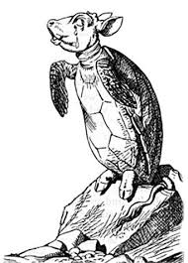
Tools to gather data about a team’s attitudes
Name those data, based on a framework for categorizing attitudes
Once named, use the properties of that category to attempt to change the attitude
Notes:
This is our POWER Start.
Our Purpose is to learn a set of tools for detecting team attitudes before those attitudes exposed as behaviors. We’re looking for the cues to behaviors not the dysfunctional behaviors themselves. We are interested in “wellness” and not the manifestation or “symptoms” of illness.
Our goal is more powerful teams, and in particular to help coaches build and continuously improve team attitudes.
What’s in it for you: a rare skill. In my experience, mostly we address team performance as behaviors, with a specific focus on managing dysfunction. You need to do that, too. But, here we’re empowering the coach with the ability shift attitudes before they manifest themselves as dysfunction.
To keep you engaged, since this is a lecture, I’ll try to wake you up with questions. We’ll use a parking lot for questions that come up during the lecture, because we’ve got a lot packed into a short time.

Slide 6
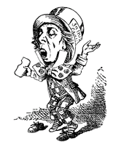
Agile: Since 2003, various roles from Scrum Master to Org. Transformation
Penn State University, Schreyer Honors College (Political Science and History)
Based on the work of Kenneth Burke and research in the field of Social Epistemology
How we think about the things we do
https://linkedin.com/in/ccurley
Notes:
About Me
I’m an INTJ. I’m C dominant, with a shift D stress response (always a great start as an Agilist).
I got lost on the way to a doctorate in Political Theory
Graduate of the Schreyer Honors College at Penn State with degrees in Political Science (Honors) and History (Distinction), plus a minor in English (writing)
Political Epistemology, the study of how we think about things
How we form groups to determine what we want the future to be like, and what action programs today are the most likely to produce future conditions closest to that desired state
Not an especially attractive field for political science
Turns out to be dread useful as an Agilist
I began working on this material
25 years ago
The hard part is to keep bringing this into a business focus / business context – to that end….

Slide 7
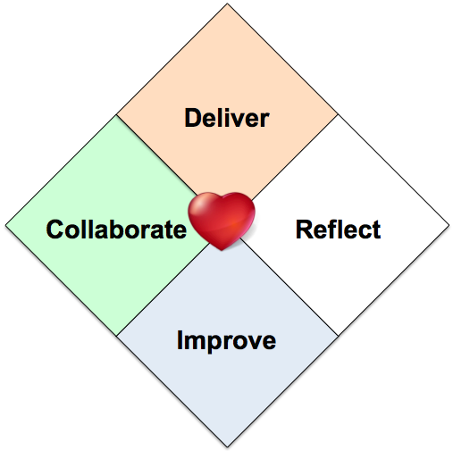
http://alistair.cockburn.us/Rediscovering+the+Heart+of+Agile
Notes:
To keep us grounded In Agile, we’ll refer back to the “The Heart of Agile” model. It will tell us “we are ‘here.’”
It’s a model for understanding Agile, authored by Alistair Cockburn.
Given the number of approaches and different models of being and doing Agile, Cockburn developed this model to help people understand what is it to be and do Agile in an “non-partisan” way.
Being Agile is reflected in the heart at the center of the diagram.
The elements of doing Agile are Collaborate, Deliver, Reflect, and Improve.
If the team has an Agile Attitude, collaborates to iteratively delivery product, reflect on the quality of the product and the effectiveness of the team, and then use what the learn to improve the product and improve the team, then that’s Agile. How exactly the team does Agile can vary from team to team, as there are a lot of ways that people can collaborate, deliver, reflect, and improve.

Slide 8
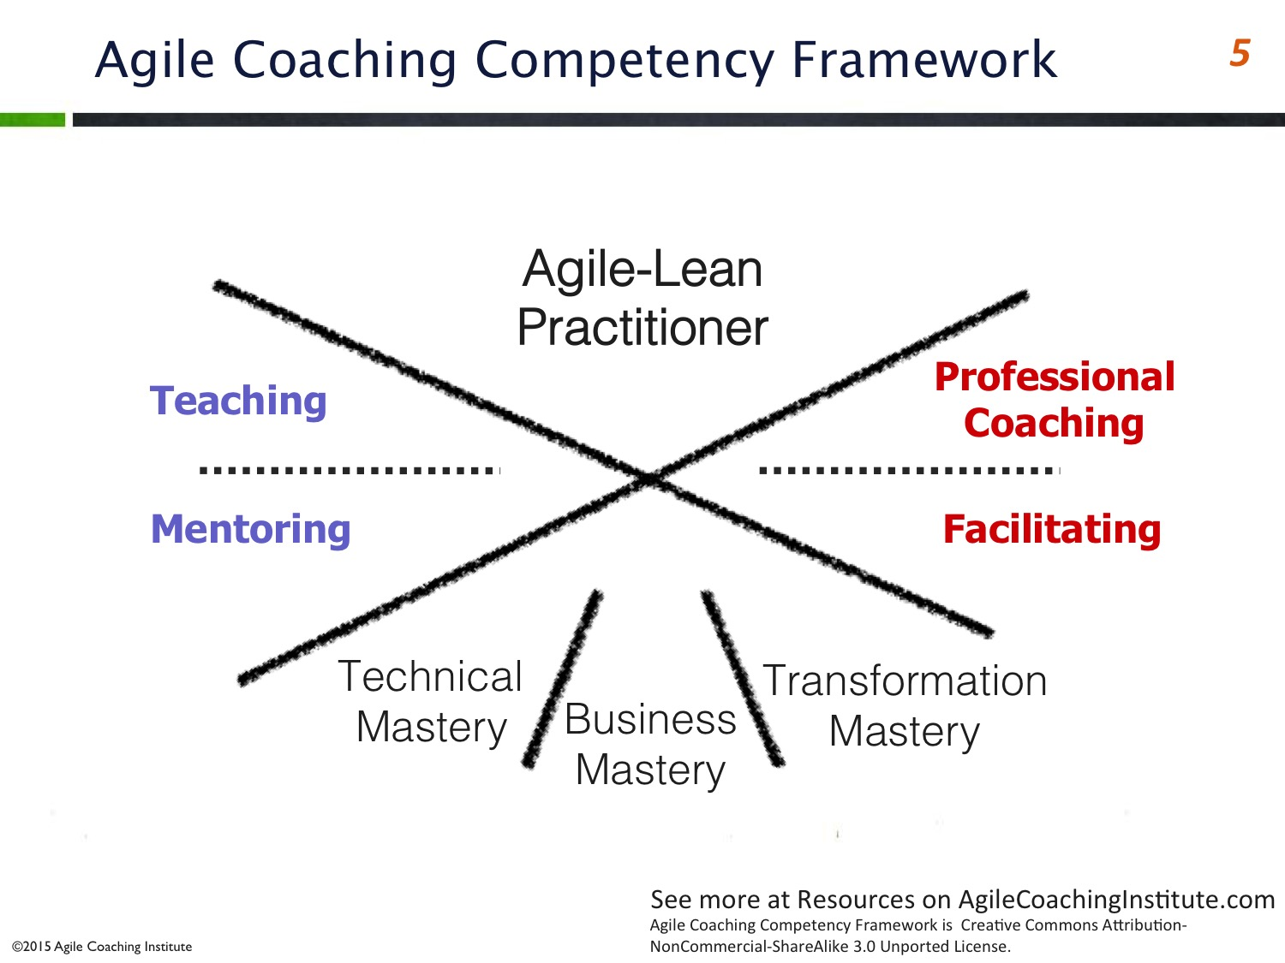
Content Expert
Process Expert
http://agilecoachinginstitute.com/wp-content/uploads/2015/03/Slide51.jpg
Notes:
This is the Agile Coaching Competency Framework. It will tell us where our coaching approach is dominantly facing.
When we get to “what do about the attitude we think we have detected,” I’ll bring us back to this framework to set the context on the DOMINANT focus of the Agile coach given the detected attitude.
To the left, this is where the Agile coach is a content expert. Teaching – sage on the stage – is what I’m doing here today. In the mentoring relationship, the mentor is the content expert imparting that expertise to the mentee in order to help the mentee accomplish a personal objective (and ideally, the mentor learns something in the process)
To the right, this is where the Agile coach is a process expert. Facilitating draws answers, agreements, and goals from the team who has the knowledge, the expertise. Coaching draws actions from individuals, who bring the problem/opportunity into the coaching relationship and discovery through the coaching process what action they think they can take to improve themselves.
Agile – Lean Practitioners build on Agile Lean foundations in order to continuously improve how they apply themselves in an Agile way to helping teams accomplish business goals. An Agile attitude – the incipient Agile action – is key to being able to act in an Agile way.
At any given time, we’re doing all of the above. What we’re looking for is a DOMINANT stance among the stance. A dominant stance may not last long, so finds herself turning frequently to adjust to something “new.” The phrase “right now” helps make this diagram more useful.

Slide 9
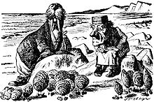
Notes:
This is dominantly teaching, by the way, in terms of the Agile Coaching Competency Framework.
It’s fairly directed “sage on stage” lecturing. Lectures tend to be a bit boring and generally uninteresting way to learn.
So, let’s at least start out with a little interaction, called “translate my definition”

Slide 10
ƒ(metaphor): compare(A, B)
ƒ(metonymy): reduce(A → {a ∈ A})
ƒ(synecdoche): substitute(A → B | B → A)
ƒ(irony): synthesize(A, B) → C
Notes:
Four definitions
Metaphor
Metonymy
Synecdoche
Irony
“The function of metaphor is comparison”
“The function of metonymy is reduction”
“The function of synecdoche is substitution”
“The function of irony is synthesis”
These are the master tropes. There are a lot of tropes – from Alliteration to Zeugma (that’s when you use a word twice in a sentence with different meanings, like “we’ll all hang together or hang separately,” or “Pickwick took his hat and his leave.” I’m certain there are plenty of examples of Groucho Marx using zeugma, but I just can’t think of any right now).
Figures of speech are tools in language. And like all tools, they can be applied well or misused.
Note: These are NOT the definitions that you will find in the dictionary. The definitions you find a dictionary for these terms (the lexical or common defintions) will confuse you. They confuse EVERYONE. They certainly confuse me. Try to distriguish between Synechdoche and Metonymy in the Webster’s dictionary. Irony, contradiction and sarcasm are very difficult to tell apart. These defintions stink, because the dictionary is trying to define these terms by what they ARE and we’re making that a whole lot easier by talking about what they do.

Slide 11
Trope | Function | Definition | Example
Metaphor | Compares | ƒ(metaphor): compare(A, B) Metaphor compares two things | Hot Water (environmental) Eat Our Own Dog Food (food) That Ship Has Sailed (travel) Toss A Grenade Over the Wall (war) Scrum (sports) Matt Hick, ”Camels”
Metonymy | Reduces | ƒ(metonymy): reduce(A → {a ∈ A}) Metonymy reduces a whole to a part | Boots on ground Resource, FTE Hands on Keyboards, Coder, Tester
Synecdoche | Substitutes | ƒ(synecdoche): substitute(A → B | B → A) Synecdoche substitutes one thing with another, and it has to work bi-directionally | “Management said...” “DevOps is on the bridge…” “We are Penn State” The Development Team
Irony | Synthesizes | ƒ(irony): synthesize(A, B) → C Irony synthesizes two things to create a new meaning | Craptacular We’re a family here (at Yoyodyne) Consensus Acceleration Servant Leader
Notes:
Using metaphor, we communicate something new by comparing it to something known. "This new thing, which is unfamiliar to you, is a lot like this other thing that you're already familiar with." We can easily convey a heavy work load with aggressive deadlines and ambitious objectives as "drinking from a firehose;" and, we can "get on the same page" without having to itemize all the facts that will help foster an agreement about what really matters. This comparative association accelerates understanding.
Metonymy reduces something into a part from its whole. The sailor is a hand; the scholar, a brain. Metonymy produces as a caricature, a picture of something with a particular aspect or feature of something or someone.
Synecdoche substitutes "a whole" with "another whole." Consider the difference between "A senior spokesperson for the Chief Executive read a prepared statement about a policy position arrived at by the President's staff and advisors and approved of by the President himself..." with "The White House said...." Or, imagine a map of a city that is actually the size of a city, and each feature of that city is on the map on a one to one scale; could you use this map? A functional map substitutes the "whole" of whatever it is it depicts with a "symbolic representation of that whole."
Irony is the most complicated of the four. It has three parts: a statement, a counter statement, and meaning we arrive at from combining the two. Irony synthesizes these the two parts into a third meaning. Irony helps us convey complexity.
The phrase "servant leader" is irony. The common or day-to-day definitions of these terms are in opposition to one another. That is, a servant is generally understood as one who follows. These two terms need to be synthesized into a new meaning. Without synthesis, the terms in the phrase compete. Team members will choose to emphasize one over the other. Typically, the Scrum Master leans to "leader" and the team leans to "servant." These ideas can be -- and frequently are -- synthesized successfully to mean, "leading the team by keeping them on the right path and making sure they've got what they need," or something similar. Of course, each team member can synthesize these terms in different ways, so the wise "servant leader" will start a discussion with the team to collaboratively synthesize these terms into an agreed-to meaning.

Slide 12
Trope | Cues | False Cues
Metaphor | Establishes understanding quickly | If the properties don’t match, you’ll take the wrong actions; metaphors can ‘fossilize’ into abstractions (“Bias” from our earlier session)
Metonymy | Focuses attention to the essence of the matter | Ridicules, exploits, objectifies: racism, sexism, and prejudices
Synecdoche | Simplifies complexity | Obscures responsibility and accountability. Inaccuracy.
Irony | Conveys complexity | Multiple different ways to synthesize. Different people get different answers.
Notes:
If the metaphor is poorly formed, then it creates a common misunderstanding quickly. We are poised to follow false cues and make mistakes. If we say “this rock is like a duck,” we’re probably going to be disappointed by how the rock floats, how the rock flies, how the rock quacks, and how the rock tastes, and how few pebbles it creates or hatches to make other rocks. Metaphor have to fit, or we confuse likeness for unlikeness.
Metonym can help us communicate the essences of something quickly, but at the risk of dignity. Metonymy reduces, which is a powerful tool to abuse others. In public conversation, metonymy is often the Nash Equilibrium – going negative. It can be easier to make someone else look ridiculous or make their ideas seem ridiculous by strategically mispresenting only a part of the whole. Sexism, racism, and other prejudices rely on metonymy to dehumanize a human. Interestingly, in the same way, Laloux’s Orange organization also requires metonymy to dehumanize humans. Henry Ford complained that his “hands came with brains,” and companies “manage the workforce with strategic reductions of the number of FTEs.”
Synecdoche has to have bi-directionality, otherwise it’s a tool for misdirecting. Synecdoche can hide accountability or obscuring the truth. Synecdoche misused is the “passive voice” of the master tropes – someone can use it to obscure a particular actor in a crowd of potential actors. “The organization decided today to layoff 10% of the workforce” is effectively the same as saying “it was decided to layoff 10% of the workforce.” If the synecdoche, like a metaphor, doesn’t point to something that is the same in its critical qualities, then the synecdoche is “a map that is guaranteed to get you lost.”
Irony synthesizes, but what each individual synthesizes may not be what the speaker intends. Swift famously proposed eating the poor as a solution to child poverty and hunger, but what the reader takes away from that can be anything from “we shouldn’t eat children,” to “Swift is insulting me.” A person who “eats the menu,” may be a glutton ordering everything available from the kitchen or an idiot confusing the words on cardboard with food on dishes. Irony as a tool conveys complexity with simplicity, but which meaning it conveys is up to the listener. It may not be the one intended. For this reason, it’s a very good idea for new teams to form an alliance statement about the meaning of “servant leader.”

Slide 13
When Engineers Stop Talking in the Technical Language of Engineering and Start Talking in the Figurative Language of Poets, Coaches Need to Pay Particular Attention.
Notes:
When people are trying to get an agreement – about a new definition of something, about a prediction, about a choice – they will often use figurative speech to make their point.
Figurative speech is a strategic moment for the Agile coach, -- [1] because the of effort that the team member is putting into being understood and [2] because of the particular choices that team member makes about figurative speech give us data that we can use to diagnose an attitude.
What figure of speech did the team member choose (knowingly, or more likely unknowingly)? Was a comparison (the most common tool). Was it a reduction of a whole to it’s part? What it the substitution of one whole for another whole? Was it an ironic construction?
How often does the team member turn to this trope?
And, so on.
This is about describing the tropes the team uses. We’re not yet doing anything with that data.

Slide 14
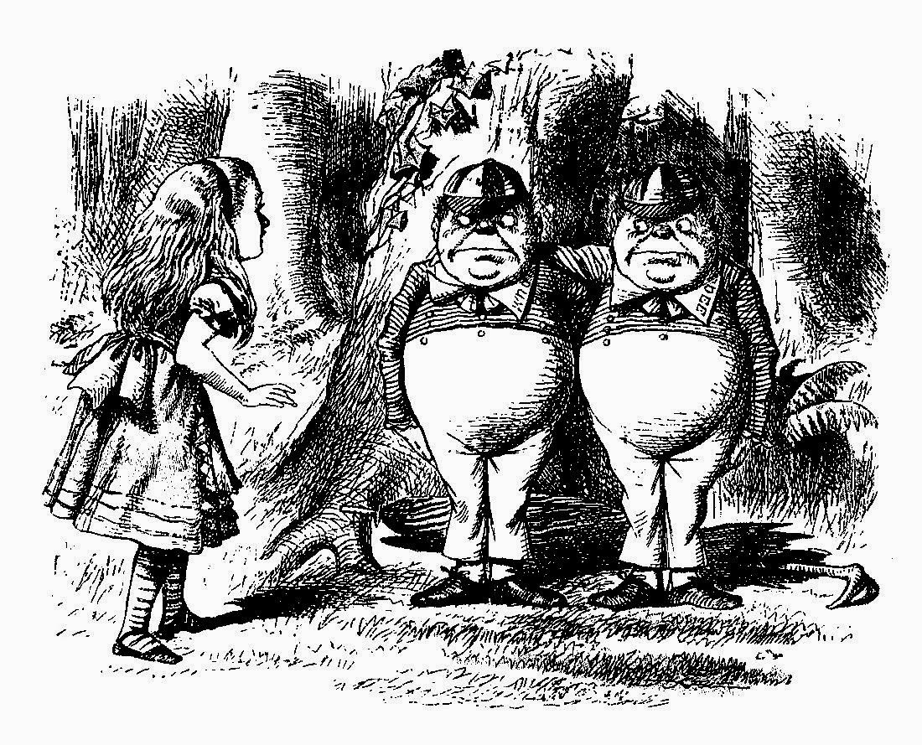
Acceptance and Rejection
Notes:
The act of accepting one thing implicitly rejects all other things; the act of rejecting one thing implicitly accepts the other things. Acceptance and rejection are two sides of the same coin. The act of turning towards is also and act of turning away. The act of turning away is also an act of turning towards. What makes ‘acceptance’ and ‘rejection,’ then, is the directionality, the emphasis, of that turn. Am I focused on a thing I explicitly accept, meaning I am implicitly rejecting lots of other things? Am I focused on a thing to reject, making myself willing to accept into myself all sort of other things.
This notion of emphasis is important, since determining something as acceptance or rejection is a question of judgement – an art. We’re looking for something that is ‘dominantly’ facing either acceptance or rejection, and we’re keeping in mind the whole of the matter. What is implicitly accepted or rejected can be more important than what is explicitly accepted or rejected. I can bring this into sharp focus: “Did your organization explicitly adopt Agile because they ‘accepted’ Agile as a way to better meet our goals, or did your organization turn to Agile because they ‘rejected’ waterfall because they fear the competition will eat their lunch when going to market?

Slide 15
Is your team turning toward Agile or turning away from Waterfall?
Notes:
When people are trying to get an agreement – about a new definition of something, about a prediction, about a choice – they will often use figurative speech to make their point.
Figurative speech is a strategic moment for the Agile coach, -- [1] because the of effort that the team member is putting into being understood and [2] because of the particular choices that team member makes about figurative speech give us data that we can use to diagnose an attitude.
What figure of speech did the team member choose (knowingly, or more likely unknowingly)? Was a comparison (the most common tool). Was it a reduction of a whole to it’s part? What it the substitution of one whole for another whole? Was it an ironic construction?
How often does the team member turn to this trope?
And, so on.
This is about describing the tropes the team uses. We’re not yet doing anything with that data.

Slide 16
The Elegiac Team
Rejection
The Satirical Team
The Burlesque Team
The Epic Team
The Tragic Team
Acceptance
The Comedic Team
Transitional
The Didactic, Grotesque, or Monastic Organization)
Notes:
The colors here have no meaning. They just help highlight the elements of the framework. This is a basic violation of Tufte’s data/ink rule. People seem to like it, however.
Try not to think of acceptance and rejection in terms of goodness and badness. Acceptance is not necessarily good, if the thing you are accepting is bad for you. Rejecting is not necessarily bad, if the thing you are rejecting is bad for you.
Accepting is an act of “turning toward” something in particular. It turns away from everything else that is not that one thing it is turns towards.
Rejecting is an act of “turning away from” something in particular. It turns toward everything else that is not that one thing it turns away from.
Accepting and rejecting is a matter of emphasis. Are you emphasizing a turning toward over a turning away? Are you emphasizing a turning away over a turning toward?
And, if this seems like an academic question, fun to argue about with a couple of drinks in you, but otherwise useless, ask this question: “Did my organization turn toward Agile because it will enable the company to adapt to the change in our strategic direction to capture our profit pool?” or “Did my organization turn away from waterfall because if we don’t figure out someway to improve our situation we’re not going to be able to compete in this market place?”
A turning away from waterfall is not the same as a turning toward Agile.
Given that we’re looking for an attitude that turns away or turns toward, we can start to narrow down what poetic categories are likely dominant on a team.
We can group teams in into three categories of “rejecting” teams and three “accepting” teams. There is also a “neither-nor” category, “the transitional.” If you’re teams are dominantly transitional, you have a lot of work on your hands.
No team is fixedly one category. Teams can be dominantly, one way or the other, seldom for long. Attitudes change, evolve, react and respond to events.
The coach is not looking to “fix” a category to a team. The coach listens to the team’s figurative speech over time. The coach is listening to detect whether one attitude comes up more often than others – and, if that one category might be dominantly so.
If a coach can assign a dominant category to a team – and gets it right – then the coach can use the properties of that category to coach the team toward improving performance.

Slide 17
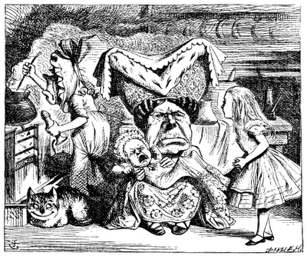
The Elegiac Team

Slide 18
The Elegiac Team complains
Everything “sucks,” “[It’s] a bucket of crap,” They’re on a “sinking ship.” They’re “the walking dead.”
They exaggerate obstacles, emphasize their own limitations
Notes:
The elegiac team is all about complaint.
Something like this is probably what happened: the team has “been transitioned to” Agile in a top-down, centralized approach to an organizational change. The team wasn’t included in the process, and now they feel they’ve been migrated from one stupid thing to another stupid thing. They didn’t have a choice in making the change or how it happened.
Dominantly, start with teaching what Agile is. The first thing you need to establish is a good foundation for “doing Agile.” This is fake it until you make it. We can’t get people collaborating, delivering, reflecting, and improving until they know what this means and why we do it. This gets us the McGregor’s X/Y theory – some people will say that “X” is just going to complain; you need to force and X to be productive. If this is the case, then no amount of teaching the “doing of Agile,” will be a way into the “being of Agile”

Slide 19
Work on “muscle memory.”
“Fake it ‘til you make” strategy.
Small, frequent instruction on Agile practices.
Quick movements, rapid benefits.
http://agilecoachinginstitute.com/wp-content/uploads/2015/03/Slide51.jpg

Slide 20
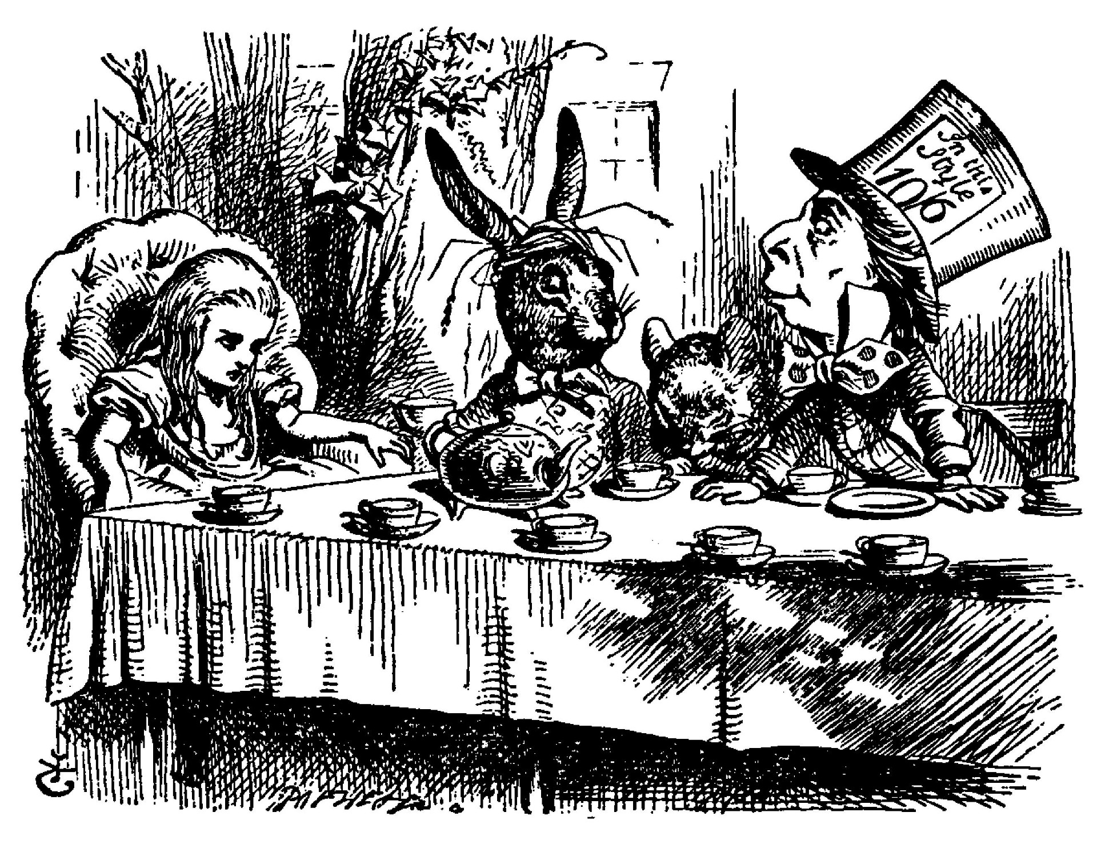
The Satirical Team

Slide 21
The Satiric Team dissembles.
Public agreement, private disagreement. “Do as I say, not as I do,” “Someone, somewhere needs to do something about this sometime.” “…put a coversheet on the TPS report.”
They exaggerate external stupidity, as if they’re not a part of that system; they make inaction look like action.
Ⓒ 2017 Christopher Curley

Slide 22
They point out the flaws in the organization outside the team.
Can that much energy be misdirected by a team that doesn’t want to succeed?
Facilitation: Re-direct the team toward usefulness.
Coaching: what is holding you back?
http://agilecoachinginstitute.com/wp-content/uploads/2015/03/Slide51.jpg

Slide 23
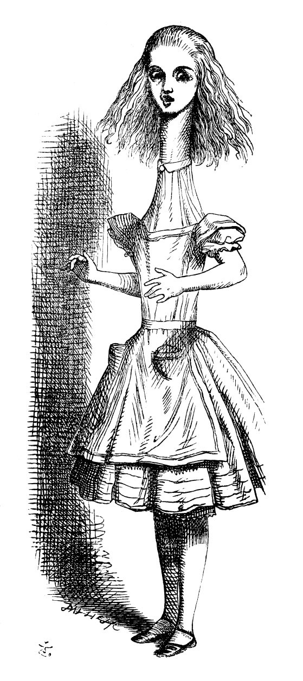
The Burlesque Team

Slide 24
The Burlesque Team ridicules
“Agile is a stand up meeting everyday” “Agile is being able change direction, suddenly”
They put all of their energy into ritual, but not the underlying reason or benefit.

Slide 25
The unintentional burlesque…
They’ve been ‘trained’ but not ‘educated’
Bring them back to the basics, emphasize the “why” over the “what”
Practical teaching, teaching in the field.
The intentional burlesque…
Ceremonies are key teaching opportunities.
The coach structures ceremonies, events, and exercises to re-direct the team toward reasons and outcomes.
http://agilecoachinginstitute.com/wp-content/uploads/2015/03/Slide51.jpg

Slide 26
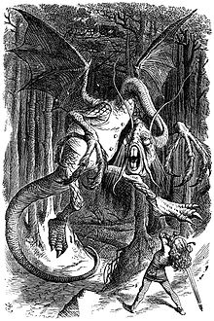
The Epic Team

Slide 27
The Epic Team endures
“The top floor demands,” “Weather the storm,” “Getting hammered.”
They put all of their energy into struggle, but no inspection or adaptations.
(Matt Hicks talking about Dev and IT Ops Mindsets… Yeah, that’s the epic mindset in action)

Slide 28
The team has “the answer,” but can’t do anything about it.
Ceremonies are key learning opportunities.
The coach structures ceremonies, events, and exercises learn to inspect and adapt the product and that team.
http://agilecoachinginstitute.com/wp-content/uploads/2015/03/Slide51.jpg

Slide 29
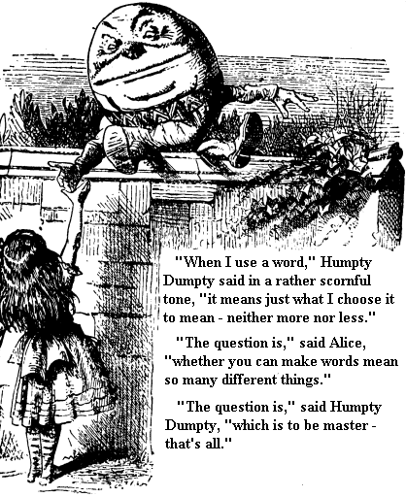
The Tragic Team

Slide 30
The Tragic Team atones
They put all of their energy into inspecting what always goes wrong, but never on adaptation.
“A leopard can’t change its stipes,” “That ship has sailed,” “We’ll never clear that hurdle.”

Slide 31
The team does have the
“the answer,” but they’re not using it.
Coaching the team members explores the question “what’s holding you back?” when it comes to incremental and iterative improvement.
http://agilecoachinginstitute.com/wp-content/uploads/2015/03/Slide51.jpg

Slide 32
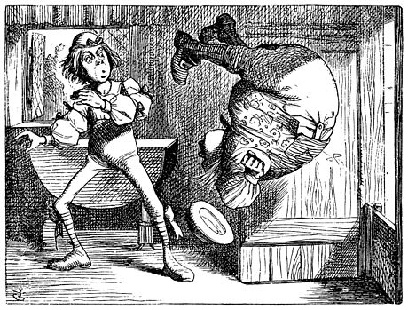
The Comedic Team

Slide 33
The Comedic Team LEARNS.
They put energy into correcting and improving.
“Well, we made a pig’s ear of that one,” “We completely tripped up,” “We fumbled the ball.”
Congratulations. The Comedic team is the only team with an Agile attitude.
Ⓒ 2017 Christopher Curley

Slide 34
http://agilecoachinginstitute.com/wp-content/uploads/2015/03/Slide51.jpg

Slide 35
Category | Faces | What it does | Tropes that tend toward or hint at | Critical Response
Elegy | Rejection | Complains | “We’re drowning,” “Living under cloud” | Coaching
Satire | Rejection | Dissembles | “We (but not me)…” “Fudging the data” | Facilitating, Coaching
Burlesque | Rejection | Ridicules | “The daily sit-down” | Teaching
Epic | Acceptance | Endures | “Pushing a rock uphill” | Facilitating
Tragic | Acceptance | Atones | “It’s our cross to bear” | Coaching
Comedic | Acceptance | Learns | “Pick ourselves up, dust ourselves off”
Didactic | Transitional (?) | Prevaricates | “We’re number one!” “Our vision rocks!” | Trans., Bus. Mastery
Grotesque | Transitional (?) | Misdirects | “We’re Scrumfall,” “We’re Waterfragile” | Trans., Bus. Mastery
Monastic | Transitional (?) | Misdirects | “We’re Scrumfall,” “We’re Waterfragile” | Trans., Bus. Mastery

Slide 36
Attitude is Incipient Action
When Engineers Stop Talking in the Technical Language of Engineering and Start Talking in the Figurative Language of Poets, Coaches Need to Pay Particular Attention
Is your team turning toward Agile or turning away from Waterfall?
The comedic attitude is the only innovative attitude
Notes:
When people are trying to get an agreement – about a new definition of something, about a prediction, about a choice – they will often use figurative speech to make their point.
Figurative speech is a strategic moment for the Agile coach, -- [1] because the of effort that the team member is putting into being understood and [2] because of the particular choices that team member makes about figurative speech give us data that we can use to diagnose an attitude.
What figure of speech did the team member choose (knowingly, or more likely unknowingly)? Was a comparison (the most common tool). Was it a reduction of a whole to it’s part? What it the substitution of one whole for another whole? Was it an ironic construction?
How often does the team member turn to this trope?
And, so on.
This is about describing the tropes the team uses. We’re not yet doing anything with that data.

Slide 37
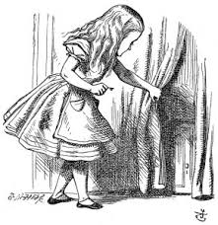
Backup Slides

Slide 38
Burke, Kenneth. Attitudes Toward History. 2 vols. New York: New Republic, 1937; 2nd rev, ed., Los Altos, Calif.: Hermes Publications, 1959; Beacon paperback, Boston: Beacon Press, 1961; 3rd rev. ed., Berkeley: University of California Press, 1984. The 1984 edition contains a new afterword, "Attitudes toward History: In Retrospective Prospect.“
… The Philosophy of Literary Form: Studies in Symbolic Action. Baton Rouge: Louisiana State University Press, 1941; 2nd ed., 1967; rev. abr. ed., Vintage paperback, New York: Vintage Books, 1957; 3rd ed., Berkeley: University of California Press, 1973.
… A Grammar of Motives, New York: Prentice-Hall, 1945; London: Dennis Dobson, 1947; 2nd ed., New York: George Braziller, 1955; Meridian paperback, Cleveland and New York: World Publishing Company, 1962 (together with A Rhetoric of Motives); Berkeley: University of California Press, 1969.
… A Rhetoric of Motives, New York: Prentice-Hall, 1950; 2nd ed., New York: George Braziller, 1955; Meridian paperback, Cleveland and New York: World Publishing Company, 1962 (together with A Grammar of Motives); Berkeley: University of California Press, 1969.
Spence, Larry D. “The Case Against Teaching,” (https://pdfs.semanticscholar.org/c2b8/4df7c0730434402f53a3a7dd1b0e7b4f841d.pdf)

Slide 39
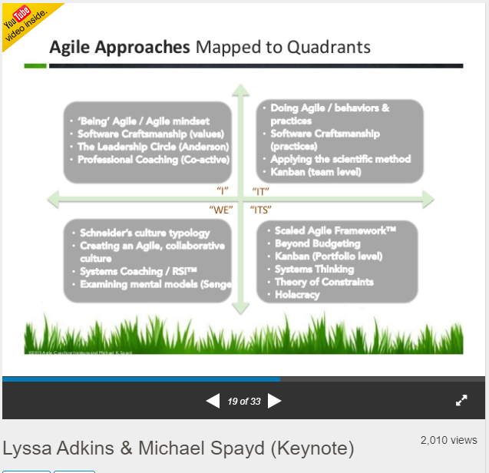
Ken Wilber’s AQAL Diagram
“I” is the first person personal pronoun
“We” is the second person personal pronoun
“It” is the impersonal pronoun uses as a provisional subject
“Its” is a possessive pronoun (the genitive), which qualifies another noun
In “Theory of Truth” representation, LL is 2nd Person (You), but in AQAL it’s 1st Person Plural (We)
Source: https://www.slideshare.net/AgileNZ/lyssa-adkins-michael-spayd-keynote
Notes:
Here’s an example of where knowing something about Grammar is actually quite useful when trying to figure out of you agree with or understanding something.
LQLH
Upper-Left (UL) - "I“ | Interior Individual | Intentional | e.g. Freud
Upper-Right (UR) - "It“ | Exterior Individual | Behavioral | e.g. Skinner
Lower-Left (LL) | "We“ | Interior Collective | Cultural | e.g. Gadamer
Lower-Right (LR) | "Its“ | Exterior Collective | Social | e.g. Marx
Theory of Truthfulness InteriorExteriorIndividualStandard: Truthfulness (1st person) (sincerity, integrity, trustworthiness)
Standard: Truth (3rd person) (correspondence, representation, propositional)
CollectiveStandard: Justness (2nd person) IN AQAL – this is “we” which is 1st Person Plural, not 2nd Person (cultural fit, rightness, mutual understanding)
Standard: Functional fit (3rd person) (systems theory web, Structural functionalism, social systems mesh)

Slide 40
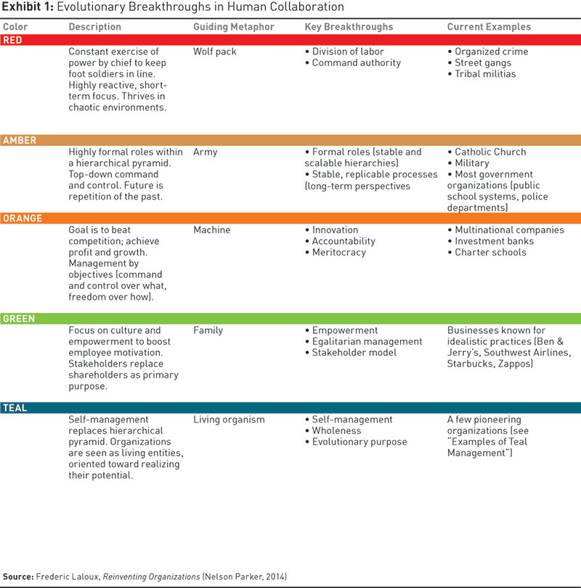
Laloux’s “Guiding Metaphors”
Like a “Wolf Pack” or “Army”
Is a “machine” or a “family”
If the organization is a machine (synecdoche) then people are its parts (metonym)
If the organization is a family, this is a really funny kind of family.
If an organization is a collection of people, then calling it a living organism might not be trope.
Notes:
Here’s an example of where knowing a bit about tropes can help you determine if you and understand and agree with something new:
Laloux uses an extended metaphor of the color spectrum to place the evolution of an organization. Not listed here is the “infra-red,” or proto-organizational conditions (e.g. natural state, pre-organization, state of nature). This metaphor doesn’t convey anything other than “position.” He has to add a metaphor to his metaphor, to explain how an organization is like red, and red is like a wolf pack. You have to wonder a bit why he didn’t “wolf pack” from the state: what is the value to calling it red, in your opinion?
In my opinion, and these are often matters of judgement requiring justification and explanation before they can be agreed to, Laloux confuses metaphor with synecdoche in the Green and Teal organization. For seventeen years, I worked for a company that said, “we are a family,” where “family” is used as a nominative predicate. They forgot it was first a metaphor (“our company is like a family,” skipped synecdoche, “We are a family unit,” and jumped straight into abstraction, “we are family.” This made we want ask that particular leader, “exactly where in the hell did you grow up?”
Laloux suggest one of the pitfalls fo the family organization metaphor is the questionable advisedness of family roles and relationships. I question the notion at all. If your work organization is a family, then you have a family the hired you into it, pays you to stay in it, demands you be productive as a condition of continued members, and regularly throws members of the family out on the street when it becomes economical advisable to satisfy the owners of the family that the P/E ratio of the family is within investor expectations. The problem with this idea is not, essentially, the family roles and relationships, but rather that it is complete nonsense – whether it used figuratively (as metaphor or synecdoche) or literally (as nominative predicate of the verb).
Laloux is seeking a metaphor to describe an organization based on inter-personal relationships that transcend defined authorities or functional roles. Family work most closely, if we are thinking of group of animals – suggesting he’d do as well selecting “pod (of whales),” “pride (of lions),” “school (of fish),” or “murder (of crows).” When we place “family,” in an array that also contains “pod,” “pride,” “school” and “murder,” we are left wondering if the metaphor couldn’t be improved somehow. This isn’t just “splitting hairs: “ these tropes cue up the actions that we select. If we say “Green is like a family, “ and “green” is in no important respects like a family, we have the wrong understanding of what “green” organizations actually are. Worse still, I can think of one organizational model that actually is like a family, but I don’t think we want to aspire to this model as an evolutionary advance beyond “Orange.” Show me a Green organization that is like a family, and I will show you organized crime (e.g. the Mafia).

Slide 41
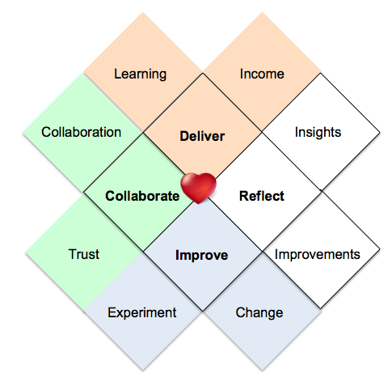
http://heartofagile.com/wp-content/uploads/Heart-of-Agile-expand-1.png
Notes:
I think Alistair Cockburn is still working all of this out. In the notion of “Shu,” “Ha” and “Ri” the “Heart of Agile “ is about as Ri as you can get. For those starting on the Agile path, it’s probably not the best way to start thinking about Agile practices, mostly I think because it requires an Agile attitude to precede the Agile practice.
In “Shu” the practice precedes a deeper understanding of “why” Agile. The “Wax On! Wax Off!” of “Shu” enables the team to get increasing adept at “Doing” Agile before they have a powerful Agile understanding or Agile Attitude. Without this practiced understanding, the result of starting with this diagram is likely to be… weird.

Slide 42
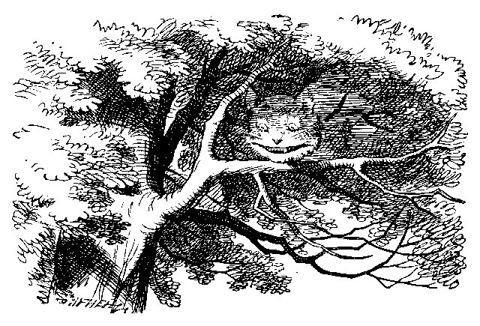
Transitional
The Didactic, Grotesque, or Monastic Organization

Slide 43
?
Applies to Organizations, impacts teams
When turning “toward” or “away” from Agile or Waterfall, the org got “lost”
Rather than changing the organization, key leaders changed words
Not an attempt to change a value stream, but an attempt to change how we think about or perceive it
This is toxic. Fast action is vital.
Notes:
There are three transitional frames: didactic, grotesque, and monastic.
They’re hard to understand, but important to recognize.
Here’s the thing: an organization transitions to Agile because it’s evolving or it’s responding to a crisis -- real of imagined. Either way, the organizational culture that supporting the company has not fully adapted to this change. There’s some reason to think that there is no “complete,” in an Agile transition, but a shift from a belief in a static organization to a stance that organizations are dynamic and continuously evolving. Think of it less as “an Agile transition,” and more of a “Agile transitioning.” Either way, when there is a crisis (real or imagined), the company is making a change so that they can act on a strategy and achieve a strategic goal. They say, “If we want to turn the corner, we’re going to have to change ourselves.” Or, they might say, “If we DON’T turn a corner, we’re going to fail.”
There are two parts to this: one is the organization, the other is this the strategy / strategic goal. We change the organization so that we accomplish the goal. The goal, of course, is to make money.
A company with a transitional frame as their dominant frame (the didactic, the grotesque, the monastic) started either with a turning towards (Agile is our answer) or a turning away (Waterfall is going to kill us), but somehow got lost. Where they ended up was neither “accepting” or “rejecting,” but… weird.
The “transitional” company turns to something that is more like magic than anything else. They change the way they think and talk about something rather than changing the thing itself. If an accepting or rejecting company is not making money – either as much money as they could be or losing money – that company would change itself or change it’s goals or both. The “magic” of the transitional company is to “re-imagine” the organization or the goal, without actually changing anything in their material world.
Here’s an example:
I used to work at Cisco, and John Chambers used to say all the time “in typical Cisco fashion,” as if there was some kind of cultural continuity in Cisco between 1996 and 2015. These companies – Cisco @ 1998 and Cisco @2015 – were not even remotely similar. The company strategy, organization, staff, revenue plans, investor relations, everything – was substantially different. Even the corporate logo to signify the company had changed. There was nothing typical about Cisco – which under went such powerful growth in such a short period to time, it was – much of the time – painful. The Cisco culture, which emerges in a real sense from the behaviors, norms (values), and artifacts of the business, was similar undergoing continuous change, also.
Amid the turbulence of this change, Cisco frequently embraced the Didactic – propaganda. Cisco’s strength was adaption and reinvention, but Cisco’s language was one of continuity and consistency. In other words, “we change without changing / we’re completely different without losing our consistent identity.” “We’re a large company with a start-up mentality.” This is, of course, horsefeathers, codswallop, and balderdash.
That’s the Didactic at work – we stretch familiar language over the change and pretend nothing has changed because they way we TALK ABOUT IT is consistent. This is pointing to a butterfly and saying it still a caterpillar, up to and including the refusal to accept the fact of the insect flying right before our eyes, because caterpillars don’t fly.
In the didactic (propaganda) we apply “Agile” names to “Waterfall” processes, and declare ourselves “Agile.” We apply the “words” in the vocabulary of an “holocracy” to an “red / amber / orange” organization and call it “evolved.” This is a holocracy where a single individual can move people in and out of circles or change out the lead links at whim. This is the continuous integration environment with stage gates and funding approvals following stakeholder review meetings. This is the “magic” of renaming something in the effort to change belief instead of reality. The Grotesque/Monastic organization does the same thing, but in the opposite way. Here, a company culture has either evolved out of its institutions (we’ve outgrown ourselves) or these institutions have stopped working properly (e.g. we’re not making a profit).
Rather than adapt, the Grotesque/Monastic organization changes the goal from a real goal (money, profitability) to a “misdirected goal.” They shift from saying “we’re here to make money,” to “being true to ourselves.” The pragmatic thing to do when result when something isn’t working is to do something different that will work; the Grotesque/Monastic approach is to keep changing the definition of the goal until what you are doing delivers it. While the company is losing money and will face certain collapse unless they change, they nevertheless believe themselves to be successful because they are “a revolution in style,” or “a modern vision to a old problem.” This is going to a restaurant, ordering from the menu, and instead of getting a meal having the waiter cut that item out of the menu and hand it to you – at which point you declare it delicious and satisfying.
This is very difficult to fix.
Running away is often the most rational response.

Slide 44
http://agilecoachinginstitute.com/wp-content/uploads/2015/03/Slide51.jpg
Notes:
If you are going to stay and fight – or if you are an enterprise transition consultant – you are mostly concerned with Business and Transformation mastery.
First, the business has lost sight of what it is about: being profitable.
In the case of Cisco, the leadership of the company laid off some 30,000 people in a roughly three-year period between 2014 and 2016. During this period, the HR culture promoted the organization as a family that valued employee retention above all else – the phrase often heard was, “we want Cisco to be the company you retire from.” One finds it difficult to rationalize this statement against 30,000 individuals restructured (though some of these people may have been offered early retirement, which is a gray area, I admit). The reason that Cisco restructured so many workers, of course, was to stay profitable – to meet quarterly expectations from Wall Street and to reposition the work force to products and services that they thought would sell better than others. That was the truth of the matter. The propaganda of the matter is that they valued employees as family members. I’m not sure many were fooled.
To be clear, I am not saying Cisco is good or bad. I’m only pointing out that Cisco worked very hard to believe it was one thing while it made choices that were in many ways completely inconsistent. Cisco has market cap of 161.33 B (as of 9/18), up from 89.04 B in Q1 of 1998. Arguably, they’re doing something right. They might as well embrace it.
Instead, they embraced the didactic.

